Slide 1
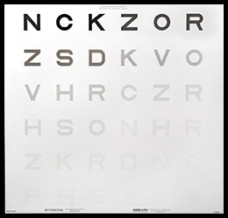
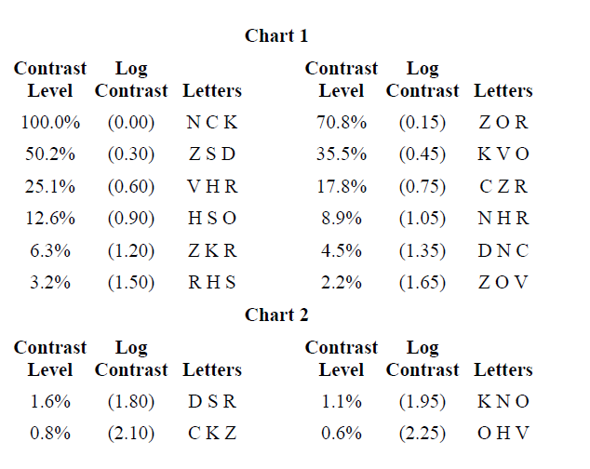
Assessment of Evans letter contrast sensitivity in measuring log contrast sensitivity.
Pinakin Gunvant Davey PhD, OD, FAAO, Raymond Maeda OD, FAAO, Aaron Seitz, PhD²
1 Western University of Health Sciences, College of Optometry, Pomona, California, USA
2 Psychology, UC Riverside, Riverside, CA, United States
Introduction
Evans Low Contrast Test
Statistical Analysis
Results
Contrast sensitivity testing maybe a better estimate of real life visual performance when compared to Snellen acuity testing
Contrast sensitivity maybe decreased in patients with early disease entities like macular degeneration, glaucoma and cataract and post refractive surgery (1-3)
Clinically numerous contrast sensitivity tests are available some that measure contrast sensitivity function at various spatial frequencies example quick CSF, CSV 1000, M&S systems . Where as The Evans Letter Contrast Test (ELCT) may be more useful in cases with decreased vision.
.
The Evans Letter Contrast Test (ELCT) chart presents Sloan Letters optotypes line size of 20/630 (a testing distance of 1m) varying contrast in sets of 3 letters of equal contrast
level.
All triplets are balanced for letter difficulty and differ in contrast by 0.15 log contrast step.
Study participants were tested at 13 feet in a dark environment and the retro illuminated box provided the background illumination for the ELCT chart. (see figure below chart 1)
The ELCT test is backlit by the ESV-3000 testing instrument, which provides a uniform luminance of 85 cd/m2.
Altman and Bland agreement plots were generated to evaluate the agreement between the contrast sensitivity function and to investigate the tests re-test repeatability obtained using the Evans Low Contrast Test.
95% limits of agreement were calculated.
The difference in measurements of first and repeat measurements was assessed using paired samples t-test.
The mean log contrast of attempt 1 and attempt 2 was 2.198 and 2.208 (standard deviation 0.17 and 0.08 respectively).
The mean difference between the groups was not statistically significant (paired samples t-test: t statistic =0.36; p value =0.72).
The Altman and Bland Plots show a non significant bias of +0.007 between each tests indicating overall there is no systematic error
(B)
A
Results
Conclusion and Discussion
The Evans Letter Contrast Test provides a quick and easy method of estimating lowest log contrast and may be useful test in identifying decreased contrast sensitivity in individuals with ocular pathology.
Purpose
The purpose of this study was to evaluate the short term repeatability of the Evans Letter Contrast Test in measuring lowest log contrast appreciated in healthy and eyes with ocular pathology.
B
(B)
Acknowledgement
Methods
We would like to thank Good-lite company for graciously providing instrument support for research activity.
Funding NIH1R01EY023582
Forty two individuals were tested twice using the Evans Letter Contrast Test. (28 ocular healthy and 14 with disease glaucoma, macular degeneration or cataract)
The mean age of the study participants were 43 years (SD 16).
Bibliography
Figure to the left
Provides the information of letters on each ELCT chart and percent contrast and log contrast of each of the triplet optotypes
1) N Yamane, K Miyata, T Samej, T Hiraoka,T Kiuchi, F Okamoto, Y Hirohara, T Mihashi, T Oshika. Ocular Higher-Order Aberrations and Contrast Sensitivity after Conventional Laser In Situ Keratomeuesis. Invest Ophthalmol Vis Sci. 2004 Nov;45(11):3986-90
2) A Ghaith, J Daniel, R Stulting, K Thompson, M Lynn, MS. Contrast Sensitivity and Glare Disability After Radial Keratotomy and Photorefractive Keratotomy Arch Ophthalmol. 1998 Jan;116(1):12-8
3) D Evans, D Gherghel D, J Bartlett, S Hosking .Contrast Sensitivity Improves Following Brimonidine Therapy in Primary Open-Angle Glaucoma: A Case for Neuroprotection? Br J Ophthalmol. 2003 Dec;87(12):1463-5
C
Questions or comments contact Dr. Pinakin Gunvant Davey
contact@pinakin-gunvant.com; or 909-469-8473

